Slide 1
Professional Practice Development
Student Name
DUE DATE:

Slide 2
Introduction
Introduction:
This assessment will cover the process of planning actions that could further your career goals and then undertaking actions that move you forward on a career pathway.
The assessment will include:
Nominating career goal.
Listing and undertaking short-term actions
Planning long term actions
Collect feedback on the actions you plan and undertake
Evaluate your processes and actions
The assessment instructions:
All sections marked in orange must be edited/filled out by you.
Screen cap images are requested for some information. This is to ensure information is not lost due to internet hyperlinks becoming broken. Please ensure you screen capture information clearly so it can be read and assessed.

Slide 3














Introduction
Introduction:
This assessment will cover the process of planning actions that could further your career goals and then undertaking actions that move you forward on a career pathway.
Conclusion – 33
Self Evaluation – 4 - 7
Occupations – 16 - 17
Networks 2 – 24 -25
Soft skills – 8 - 11
Tech skills – 18 - 19
Information – 26 - 28
Financials – 29 - 30
Hero reference – 12 - 13
Studios – 20 - 21
Cool tools – 14 - 15
Networks 1 – 22 - 23
Job Adverts – 31 - 32

Slide 4
Self Evaluation|Self Introduction
What are your goals? What are the right goals for you? What do you need to do to achieve your goals?
The questions below are designed to give you an overview of yourself to help plan where you should focus your time and energy. This will give you better insight to choose goals and plan how to achieve them.
Take some time to answer these questions (and consider others like them).
 | Self Introduction
Why are you studying at AIE? | To peruse a dream of mine to become a game designer
What hobbies do you have that are closely related to your AIE course work. | Playing video games Being a dungeon master in Dungeons and Dragons Coding
Do you have hobbies that are not at all related to your course work? | AFL Racing
Do you think you have an “artistic” side to your character? | Yes, I like to create worlds and give others a creative outlet.
Do you think you have an “technical” side to your character? | Yes, I like to build things like computers and do some coding

Slide 5
Self Evaluation|Self Introduction
 | Self Introduction
Do you feel you are a creative person? How can you be sure? | I know I’m a creative person because I made a world in D&D and made it my own way with a version to ensure my players had fun even if it’s the same mission they did not long ago.
What job role specialisation do you find most interesting, right now? Why? | Level design I love being able to create areas and worlds where I have to either create emotion or get the player to do a certain objective without them knowing.
What software is the most interesting to you, right now? Why? | Maya, as I have never used it to a high level before and learning a new program is a big step to my goal.
Can you describe a strength that might serve you well whilst studying to become a professional? | Realistic work amounts. I have a very creative mind where I can dream up massive ideas but I can also make an idea that can be big, but start small and fun that can become a large project.
Can you describe one weakness relevant to your study you feel might need some improvement? | I become very tired after a while of working, and my productivity slows down at the end of the day and week.

Slide 6
Self Evaluation|Self Introduction
 | Self Introduction
Describe one of your strengths that might give you an advantage in the workplace? | I am a quick worker when I am focused, and I become hyper focused to the point I forget about time and my surroundings, doing this doesn’t make me tired for the rest of the day.
Describe one of your weaknesses that might give you trouble in the workplace? | I am distracted by things easily and when something keeps distracting me from my work, I wont be able to focus for most of the day.
Do you think you are an introvert or an extrovert? | Both, I like to be left alone but I also enjoy talking with people and going out.
Do you find it difficult or easy to communicate concepts and ideas to other individuals? If not why? | This depends on if I have the idea clear in my own head, if I know what I'm talking about there's no doubt ill be able to tell others clearly in a way they will understand and change the way I talk on the fly in case they don’t understand. But my anxiety will stop me from telling people in the first place.

Slide 7
Self Evaluation|Self Introduction
 | Self Introduction
Do you like to express your self in writing? Do you feel you write well? | I can write well and creatively, but the only thing holding me back is spelling and using words on paper to get other people to understand what I'm saying.
Do you feel you are good with math and numbers? Could you write, read or use a math formula? (Eg: F=ma or S=d/t or C=2πr) | I like to think I'm good at math, (a*b(10+6)/x)² = 4096 Answer:| (4*2(10+6)/2)² = 4096|
Do you have any coding, scripting or programming skills? | I have used python which I understand pretty well. And I understand a small amount of C#.
Do you have traditional or digital art skills? (Eg: drawing, illustration or painting skills?) | I don’t have any true skills in art, I've been practicing lately, still a lot to learn.

Slide 8
Soft skills|Definition
Research what is meant by the term “Soft skills”.
In your own words write a short, accurate description of what the term “Soft Skills” means in the context of a workplace.
The meaning of the term Soft Skills in a work context.
Soft skills are everyday skills also known as people skills, the ability to communicate with others about topics as workload and progress.

Slide 9
Soft skills|List of skills and meanings
What are common soft skills? What do they mean?
Compile a list of different but common types of soft skills (approx. 7).
Write in your own words a description of each soft skill
Types of soft skills | Different words used describe the same type of soft skill
Public speaking | Presentations and group meetings are also forms of public speaking the ability to talk confidently Infront of others
Adaptability | The ability to change to a situation that has happened and rising to the task of doing the new task.
Teamwork | The ability to work and get along with others in any situation and help those without issues, all for one and one for all.
Time management | The ability to allocate your time correctly and factor in other situations, knowing what you can do in x amount of time.
Problem solving | The ability to think of a solution and find any problems that could get in the way of your work, this also includes planning ahead and planning for the past.
Work Ethic | Your ability to work and how much you work, how fast you work, and how you work with others.
Communication | Speaking to others about anything, weather it be a person issue, or work related advice, the ability to talk with others.

Slide 10
Soft skills|Personal vs Team
Research soft skills that have a team focus and ones that have a personal focus.
In your own words make 2 lists.
One list of soft skills that are largely personal
One list of soft skills focused on teams in a workplace context.
Soft Skills – Personal focus | Soft Skills – Team focus
Creativity Problem solving Work ethic Conflict resolution Critical thinking Motivation Dependability | Leadership Communication Teamwork Time management Positivity

Slide 11
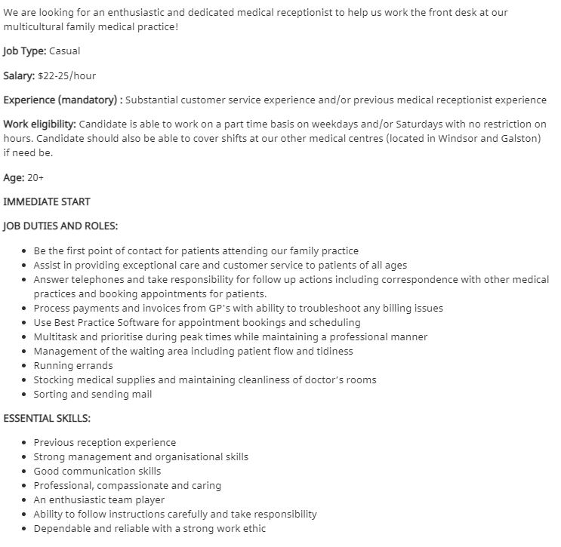
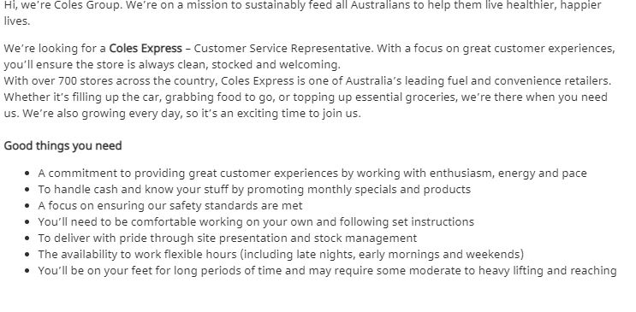
Soft skills|Identify
Take a screen shot of a 2 job adverts.
Identify and highlight some of the soft skills listed in each advert.
Job advertisement #1 | Job advertisement #2
Post screenshot here | Post screenshot here

Slide 12
Hero Reference|Cool people
Research professionals currently working in industry.
Find 2 professionals who's work you find inspirational.
Post a link to their portfolio or examples of their work and explain what inspires you.
List of cool pros | Name | Link to work examples | Why are you inspired?
Cool pro #1 | Hideo Kojima | Hideo Kojima Games List - All Video Games Made by Hideo Kojima (ranker.com) | He created games that people loved, and caused a generation to grow up with some of his games influencing the shape of games today.
Cool pro #2 | Shigeru Miyamoto | List of Nintendo games created by Shigeru Miyamoto - Codex Gamicus - Humanity's collective gaming knowledge at your fingertips. (fandom.com) | He had a slump of a game where he wasn’t happy with the quality and how it turned out, so instead of leaving he worked harder and put even more time into his next big game.

Slide 13
Hero Reference|Pro Skills
What skills do your chosen pros have? What soft skills do you think they might need to have?
What software do they use? If you don’t know the software, they use what software do you expect they use?
What job roles do they have? What job roles could they have?
In your own word write a short description of the skills these people have and the software they use. Also describe you job title they actually hold or what job title you think they could hold.
List of cool pros | Tech skills and soft skill set | Software knowledge | Actual or Possible Job title.
Cool pro #1 | Leadership Time management | Maya The Decima Engine | Game Designer
Cool pro #2 | Public speaking Presentation | Nintendo game engine Max or Maya | Game Designer

Slide 14
Cool tools|Software
List 2 pieces of software you think are really cool.
In your own words explain what the software actually does.
Explain what about the software interests you?
List of cool software tools | Name | What does it do? | Why does it interest you?
Software #1 | Maya | Creates Models | It’s a new program that is used by most game studios.
Software #2 | Unity | Game engine | It’s a easy to learn game engine that allows my visions come true.

Slide 15
Cool tools|Software developers
Who develops the software?
Does the developer provide support to the user base? For example, do they post tutorials on their website? Do they have forums for discussions? Does the developer post video on YouTube?
Does the developer have some type of active social media?
List of software tools devs | Name | What training support is offered? | Are official forums available? | Do they have an active social media presence?
Software developer #1 | Adobe | Basic tips | Yes | No
Software developer #2 | Unity Technologies | Full tutorial | Yes | No

Slide 16
Occupation|Job Roles
Research 3 studio job roles.
Identify 3 actual job titles use by professionals and studios.
In your own words give a brief description of what that job role is.
Job Title | Description of job role
Level Designer | A level designer designs and builds a level and make it look nice and
Narrative Design | A narrative designer is a story teller, someone who writes the story for the game.
Sound Design | A sound designer is the one who makes the sounds you hear in the game, from button pushes to music.

Slide 17
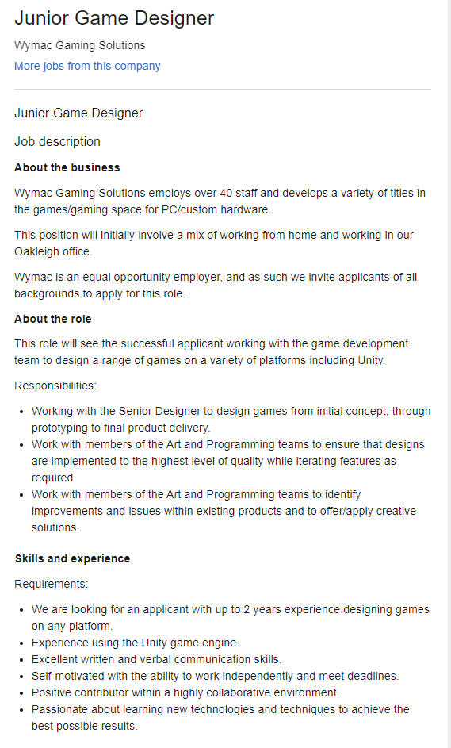
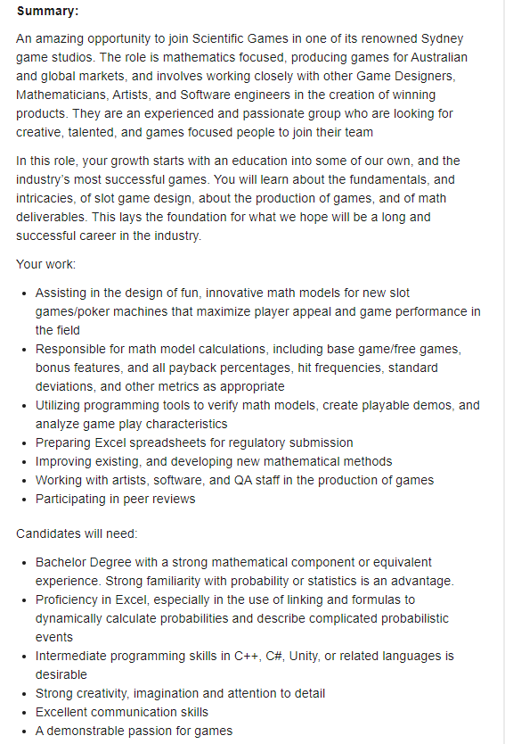
Occupation|Job Roles
Find 2 job advertisements you'd be interested in, each from a different source.
Highlight the source and paste a screen shot of each job advertisement below.
Also post a link to the source of the job adverts
Job advertisement #1 | Job advertisement #2
 | Post screenshot here
https://www.seek.com.au/job/52079552?type=standout#searchRequestToken=7e6f3ac2-ed83-49c4-9458-15fa984545d2 | https://www.seek.com.au/job/51942169?type=standard#searchRequestToken=39c2edb6-92a4-42f9-9fda-d87d9977bd5a

Slide 18
Tech skills|List
Compare 2 of your technical skills. These could be things like animating, modelling, rigging, unwrapping etc.
Discuss one technical skill you feel you are currently “good” at and would find easy to learn more.
Discuss one technical skill you feel you are currently “poor” at and would find it difficult to learn more.
Discuss why one skill is easy for you and the other is difficult.
Easy and confident skill technical skill | Difficult and poor technical skill
Animation in unity I find it extremely easy to use and simple. As well as its all easy to understand. | Modelling This is difficult to me as I'm still new and learning it and have a lot to understand with it. The tools sometimes doesn’t make sense as well.

Slide 19
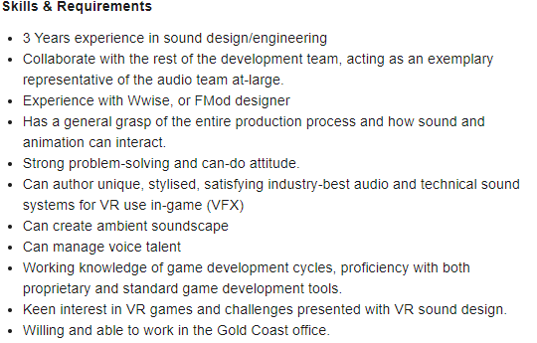
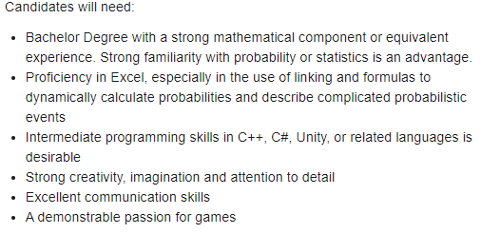
Tech skills|List
Take a screen shot of 2 job advertisements.
Identify and highlight some of the technical skills in each advertisement.
Job advertisement – Tech Skills #1 | Job advertisement – Tech skills #2
Post screenshot here | Post screenshot here

Slide 20
Studios|Studio list
Identify a few studios near to you (local studios) and post a link to their website. (3)
Identify some international studios and post a link to their website. (3)
Local studio name | Link to studio website
Chaos Theory | https://www.chaostheorygames.com/
Reach Game Studios | https://www.reachgamestudios.com/#intro
Mode Games | https://mode-games.com/
International studio name | Link to studio website
CD Projekt | https://en.cdprojektred.com/
Bethesda | https://bethesda.net/en/dashboard
Valve | https://www.valvesoftware.com/en/

Slide 21
Studio|Studio review
Choose one local and one international studio from your list.
Research them and report on some findings, focusing on what they produce or how they produce it. Ensure you are reporting accurate information.
Find out what software they use?
Find out how many staff they employ?
Find other information about how the studio produces its products?
Studio name | Production trivia
Chaos Theory Games | Game engine is Unity and unreal Uses the HTC Vive for VR Work with a wide range of brands.
CD Projekt | 1,111 Employees (2019) Develop/code in C++ Use of Maya and photoshop

Slide 22
Network 1|Personal close
Think about your immediate personal network. Think about the people who can offer you advice and feedback.
These are people who you can talk directly with. These people may include family, friends, fellow students, trainers, work colleges, etc
How many people in your immediate personal network could you:
call on for advice on artistic / technical matters.
call on for advice on soft skills related matters.
call on for advice on employment and job-related matters.
 | Personal close network (approximate size)
Artistic / technical matters | Approximate number of close contacts
Soft skill related matters | Approximate number of close contacts
Employment / job related matters | Approximate number of close contacts

Slide 23
Network 1|Personal Extended
Your personal extended network is made up of people who you are not in direct contact with.
This could include people you don’t know in person, but are a member of a group you are a part of (eg a social media group)
This could also include people you know of. You may need to talk “through” other people to make contact.
These people are “2 steps” away.
In the box below describe the scope and extent of your personal extended network.
Do you “know of” some people who could help you develop as a professional?
Do you have access to a group of people who could potentially support you? (eg a Facebook group)
Do you have some form of extended network you can get feedback or even advice from?
 | Extended network
Describe the extended network you have right now! | Answer here
Are there any easy steps you could take to expand you current extended network? | Answer here

Slide 24
Network 2|Community close
Look for 2 local communities you could personally interact with that could help you develop professionally. Focus on finding local groups that are near to where you are now, that you could have easy access to.
The community could offer …
A competition
Interaction with like minded people
Networking
Feedback
Answering questions
Describe (and link to) the communities in the box below.
 | Close / local community
Physical community | Answer here
Online community | Answer here

Slide 25
Network 2|Community Extended
Look for a big external event that would be valuable for you to attend. This could be a conference or expo that hosts industry developers, speakers and community. Write a short description of why it would be valuable to attend.
Find out the basic details of the event.
Link to the website
When is it on this year?
How much would it cost to attend. (approx.) Include ticket prices, travel, accommodation and anything else needed.
event name | Link to website | When is it on | Ticket prices | Travel expenses (approx.) | Accommodation expenses (approx.) | Other expenses (approx.) | Total cost
Name | Link | date | $...? | $...? | $...? | $...? | $...?
Why would it be worth attending?
Answer here

Slide 26
Information|Sources News
Look for 2 information sources on industry news.
Carefully choose your sources to ensure you get industry news that is of good quality.
This could be from the following –
Social media source
Website / news articles
A specific individual
Briefly describe and link to the sources below.
 | Link | Name of source | Describe source | Why is it a “good quality” source?
News source #1 | Answer here
News source #2 | Answer here

Slide 27
Information|Sources Skills and tools
Choose a skillset and software tool you are interested in. For example, Unity and Level Design.
Identify 2 sources of tutorial information for that skill set and software tool combination. Ensure you are choosing a good quality information sources. Link and discuss the source below.
 | Link | Name of source | Describe source | Why is it a “good quality” source?
Skill / tool set #1 | Answer here
Skill / tool set #2 | Answer here

Slide 28
Information|Future
Games Development is a fast-moving industry.
Look for some emerging technologies, software tools, processes, hardware or workflow that interest you.
In the box below describe one emerging technology. Describe a few actions items you might need to take that could move you closer to participating in this new emerging technology.
Technology name | Describe new technology | Action items for participation
Answer here | Answer here | Answer here

Slide 29
Financial|Costs
Select a small suite of software that could make the core of your professional home studio.
The suite of software should include both 2D and 3D editing tools as well as some additional software for tasks such as design or editing.
Ensure you are considering software licensing for professional (paid) work.
Software name | Link to website | Cost of professional licence
Name | Link | $...?
Name | Link | $...?
Name | Link | $...?
Name | Link | $...?

Slide 30
Financial|Hourly rate
Do some research on hourly rates for freelance Designers.
In the box below
Nominate an approximate figure you think is fair as an hourly rate.
Briefly discuss how you arrived at that figure.
 | Answers
Nominate an hourly rate | Answer here
Discussion of how you chose that rate | Answer here

Slide 31
Job Adverts|Find and list
Look for 2 information sources that host industry job adverts.
Carefully choose your sources to ensure they are legitimate.
This could be from the following –
Social media source
Website / news articles
A specific individual
Briefly describe and link to the sources below.
 | Link | Name of source | Describe source | Why is it a “good quality” source?
Job advert source #1 | Answer here | Answer here | Answer here | Answer here
Job advert source #2 | Answer here | Answer here | Answer here | Answer here

Slide 32
Job Adverts|Choose
Select 2 job adverts that you find interesting. Choose an advert for the type of job you’d like to see yourself in the future.
Ensure you are selecting from a good source. Preferably this is an info source you have reviewed and checked for quality before.
Describe why the chosen job advertisements are appealing to you.
Identify what you think are the key soft skills and tech skills the job requires
 | Link to job advert | Title of position | Describe why it interests you | Soft skills and Tech skills
Job advert #1 | Answer here | Answer here | Answer here | Answer here
Job advert #2 | Answer here | Answer here | Answer here | Answer here

Slide 33
Conclusion|Where to next?
This document is designed to help you explore and plan your professional development.
You have added a lot of data to this document. Make use of this data and draw a conclusion.
Review and analyse the information above and summaries into a few key conclusions.
What does the data show? | Link to job advert
What is one weakness you have where you should focus more attention? | Answer here
What is one strength you have that will be valuable in the future? | Answer here
What inspires you? | Answer here
What are your goals? | Answer here
What is a short term action item you recommend you should do? | Answer here
What is a long term action item you recommend you should do? | Answer here

Slide 34
Professional Studies 1|Submission
The following files must be uploaded to Canvas for assessment. All submitted files must adhere to the provided naming conventions.
Workbook:
This Workbook
2021_Professional_Studies_1_YourName.pptx

